Slide 1
Who are we?
SAC is a group that elevates school spirit here at Allegany-Limestone.
Each individual class has a President, Vice President, Secretary, and Treasurer.
SAC then has its own President, Vice President, Secretary, and Treasurer who are all seniors. These seniors will mentor their junior counterparts, so there is a smooth transition from year to year.
This Photo by Unknown Author is licensed under CC BY-SA-NC

Slide 2
What do we do?
Dances (not prom) – decorating, organizing, clean up
Spirit weeks
Assemblies
Homecoming parade
Court
Tournaments (dodgeball/volleyball)
Class competitions

Slide 3
Breakdown
Freshmen class officers – 4
Sophomore class officers – 4
Junior class officers – 4
Senior class officers – 4
SAC officers – 4 (can only be seniors)
SAC JR officers – 4 (can only be juniors)

Slide 4
What are the roles of the entire group
1) Planning and Preparing for SAC events
2) Decorate for and clean up after SAC events
3) PARTICIPATING IN ALL SAC EVENTS!*
4) Get feedback/ideas from your classmates
5) Attend SAC meetings (official meetings once a week)
*if it is a paid event and you or any other students cannot afford to participate but wants to attend, they should see Mrs. Straub.

Slide 5
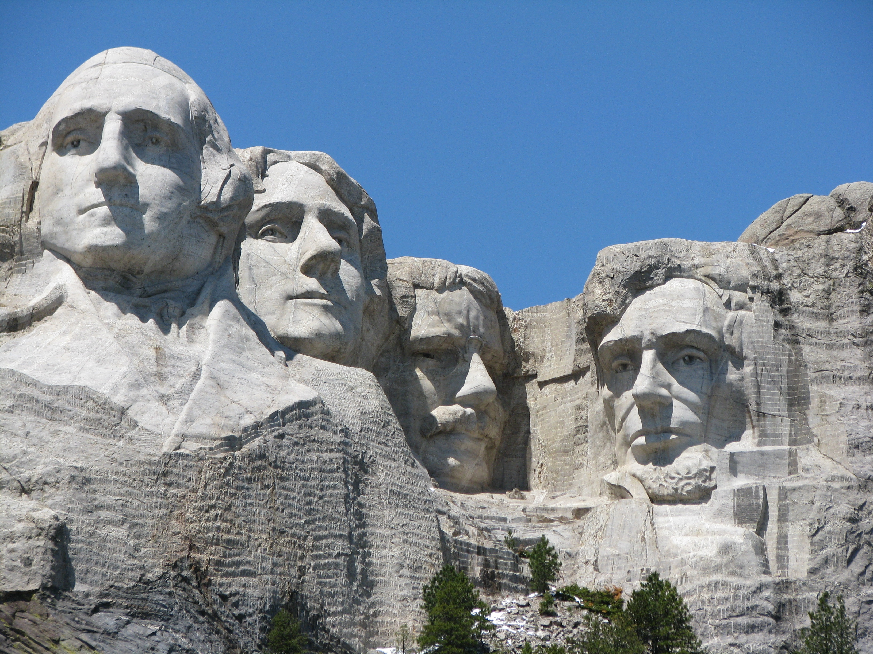
SAC Executive officers/ officers in training
President and VP – help plan agendas, research, and have ideas.
Secretary – take meeting minutes and send them promptly.
Treasurer – count/sign for money POs and monthly ledgers.
Officers must be involved in Prom Planning committee and help decorate their hallways.
Plan and execute both assemblies, organizing extra events (bonfire, dodgeball, volleyball), and 4 of you (2 jrs and 2 srs) must sit in on Homecoming organization team and the other 4 (2jrs and 2 srs) must sit on the Winter Weekend organization team

Slide 6
Senior Class officers
Football concessions stand - help your advisors to work the concession stand for the home games or help them find students who will work the games (2-3 students per game)
Work with Mrs. Straub to organize Homecoming dance and parade. The theme and spirit days would be approved by everyone, but you are responsible for advertising, ticket sales, ordering decorations, and going with us to shop for food, door prizes etc)
Consult on prom committee
Help plan the senior trip
Help with hallway decorating

Slide 7
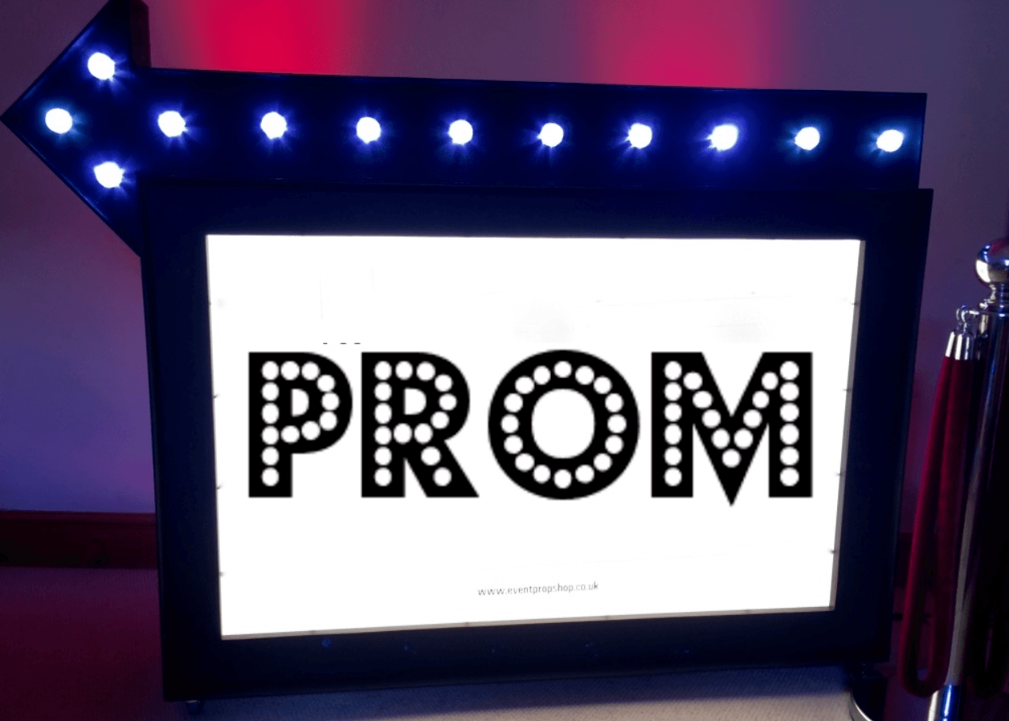
Junior class officers
Football concessions stand - help your advisors to work the concession stand for the home games or help them find students who will work the games (2-3 students per game)
Lead the Prom Committee (ticket sales, decorating/ordering decorations, choosing a theme etc)
Help decorate hallway

Slide 8
Sophomore class officers
Basketball concessions – help your advisors to work the concession stand for the home games or help them find students who will work the games (2-3 students per game)
Help with hallway decorating
Work with Mrs. Straub to organize Winter Weekend. (The theme would be approved by everyone, but you are responsible for advertising, ticket sales, ordering decorations, and going with us to shop for food, door prizes etc.)
This Photo by Unknown Author is licensed under CC BY-NC-ND

Slide 9
Freshmen class officers
Basketball concessions – help your advisors to work the concession stand for the home games or help them find students who will work the games (2-3 students per game)
Help with hallway decorating
Work with Mrs. Straub to add to the Arts Fest experience. (May)
This Photo by Unknown Author is licensed under CC BY-NC-ND

Slide 10
I am excited for you to join the SAC team! If you are interested, please: Turn in your pre-election form to Mr. Ahl or Mrs. Straub BEFORE 3pm on Friday, May 17th.

